Slide 1
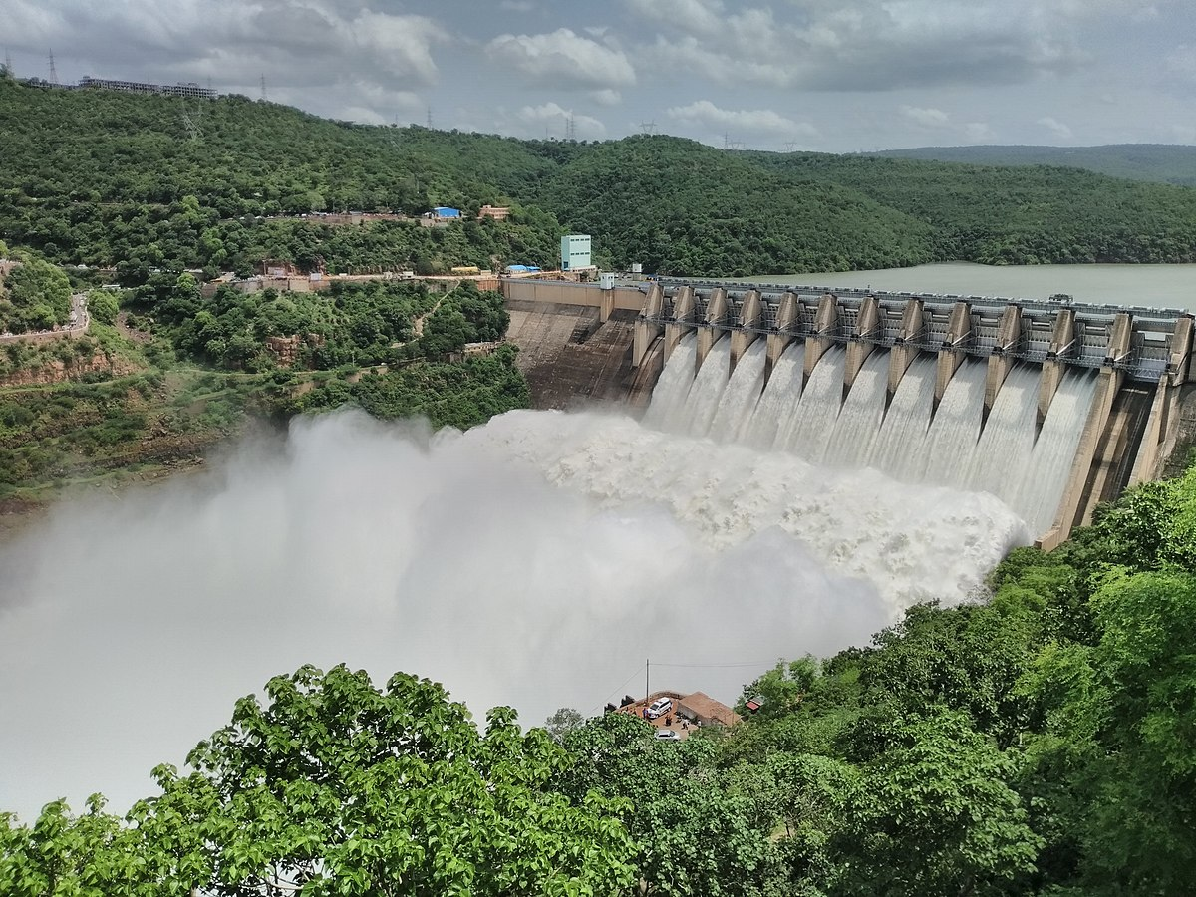
Dam Monitoring and Alerting System
Submitted by-
Hardik Agarwal (2020UCO2115)
Piyush Singh (2020UCO1700)
Yash Jindal (2020UCO1689)

Slide 2
CONTENT
S No. | Topic
1. | Introduction
2. | Motivation
3. | Problem Statement
4. | Novelty
5. | Literature review
6. | Methodology
7. | Hardware and Software
8. | Prototype
9. | Results
10. | Issues
11. | Conclusion
12. | Github Repository
13. | Total cost Distribution

Slide 3
Introduction
The Dam monitoring and alerting system is an Innovative system which helps in solving all the dam related problems.It switches the dam operation from manully to completely automated.

Slide 4
MOTIVATION

Slide 5


Existing system
FLOOD
LEVEL
Dam releases large amount
of water causes flash floods
Dam did not release water
when it is required
FLOOD LEVEL
IRRIGATION LEVEL
IRRIGATION LEVEL
LOOP LEVEL
LOOP LEVEL

Slide 6
Dam Failures
Uttarakhand Dam Failure Flood(2013)
killed about 6000 people
Tiware Dam Failure Flood (2019)
killed about 123 people
Dhauliganga Dam Failure Flood (2021)
killed about 180 people

Slide 7
Problem Statement
We aim to build a system that will reduce the human intervention from the existing dam control system and automate it , that can the make the system more efficient and accurate, hence reducing the chances of dam failures and related problems like flash floods , insufficient water supply to downstream etc... For this we propose an IOT-based dam monitoring and alerting system.

Slide 8
Novelty and Contribution
This system uses an efficient algorithm.
This system provides early alerts for flood condition.
This system uses Node-red for interfacing and ThingSpeak as the cloud.

Slide 9
Literature review
In the paper by Dr. Nagesh Shivappa et al. proposes a system capable of controlling the health of dam by using IoT to improve dam monitoring and water flow control. The proposed method uses microcontrollers, sensors and control valves to automatically control water distribution during crises using statistical data from the environment.
In the paper by Rabiya Basreen et al. proposes a system consists of sensors that are placed in different locations of the dam to measure the water level and send the data to a microcontroller. Further the microcontroller processes this data sends it to the cloud server. The cloud server then analyses it and based on it send alerts to the authorities for any critical condition.
In the paper by Dr. S. Janani et al. proposes to automate a dam system using an Arduino-based automation system, ultrasonic sensors, a GSM module, and motors. The proposed system will collect real-time water level using ultrasonic sensor and based on this the system provide alert to the people living on the shore and also control the dam gate

Slide 10
METHODOLOGY

Slide 11
Proposed system
WATER
LEVEL MONITORING
FLOOD
ALERTING
SYSTEM
GATE
CONTROL
(AUTOMATED)
AGRICULTURE
WATER
SUPPLY

Slide 12
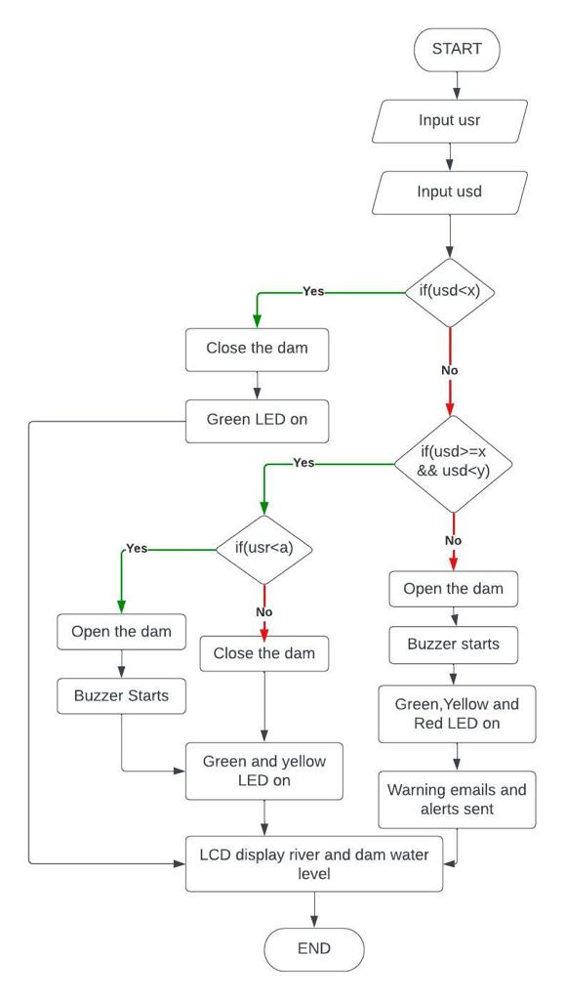
Decision Algorithm

Slide 13
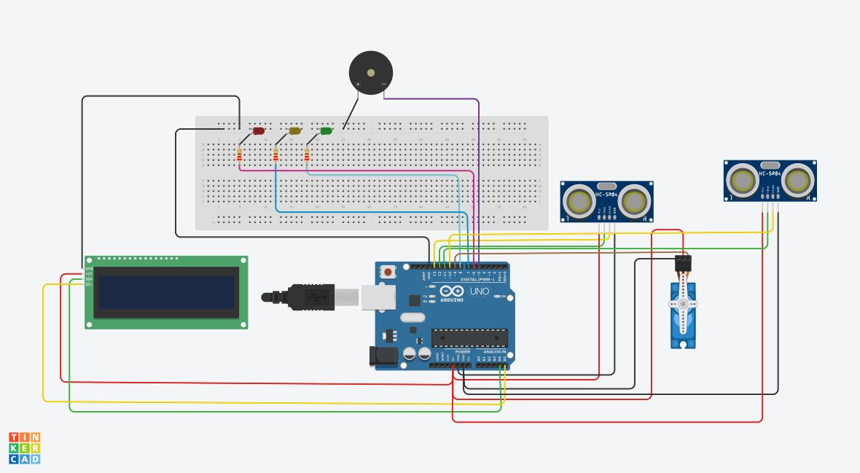
Circuit Daigram

Slide 14
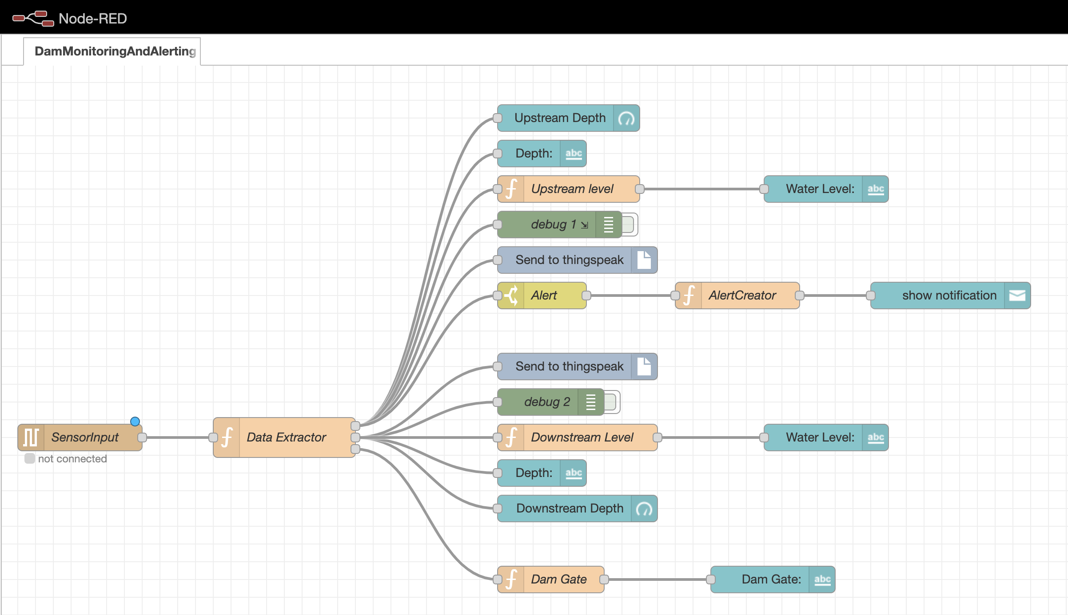
Node-Red Interface

Slide 15
Dam level rises due to rain
or glacier melts
Our system
FLOOD
LEVEL
Dam releases signifficant amount of water
for agricultural activities
alert sent to people
FLOOD LEVEL
IRRIGATION LEVEL
IRRIGATION LEVEL
LOOP LEVEL
LOOP LEVEL

Slide 16
Requirements
Hardware
Software
Arduino UNO
Ultrasonic sensor
Buzzer
Servo motor
Node - Red
Aduino IDE
ThingSpeak
IFTTT
Tinkercad

Slide 17
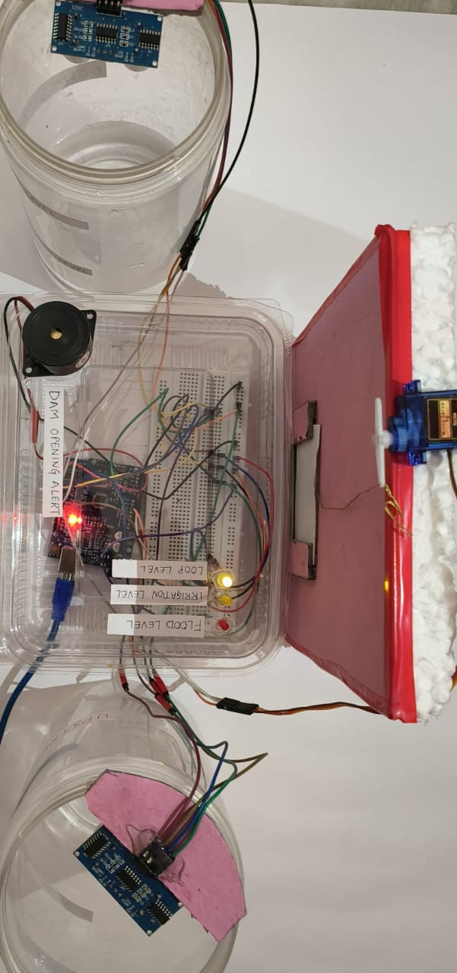
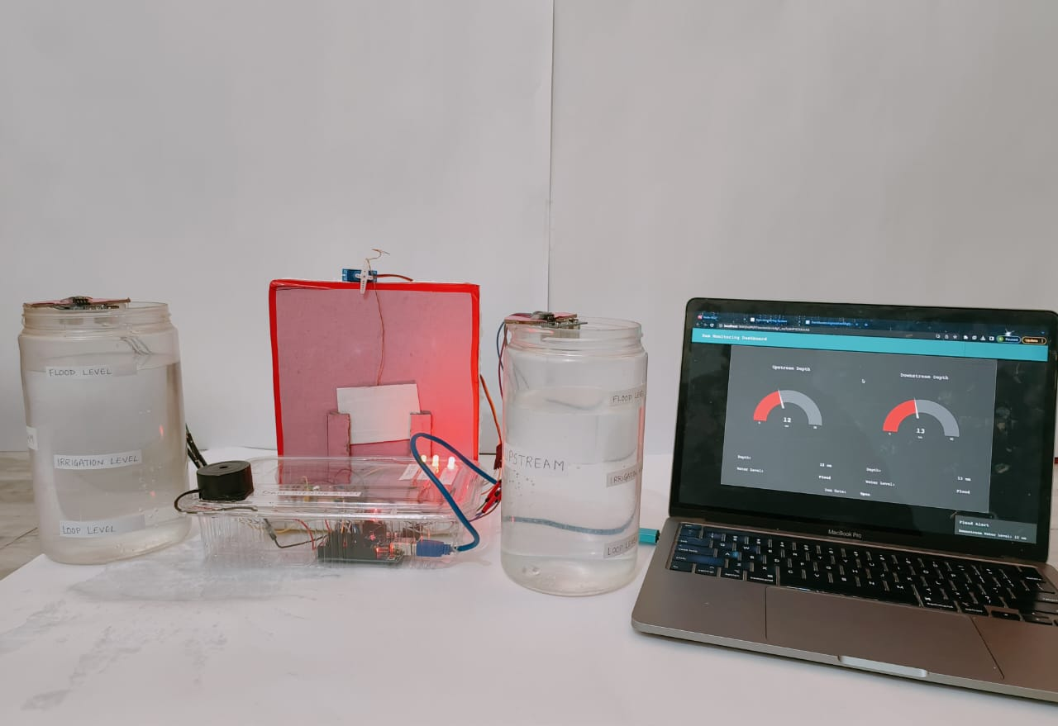
Prototype

Slide 18
RESULTS

Slide 19
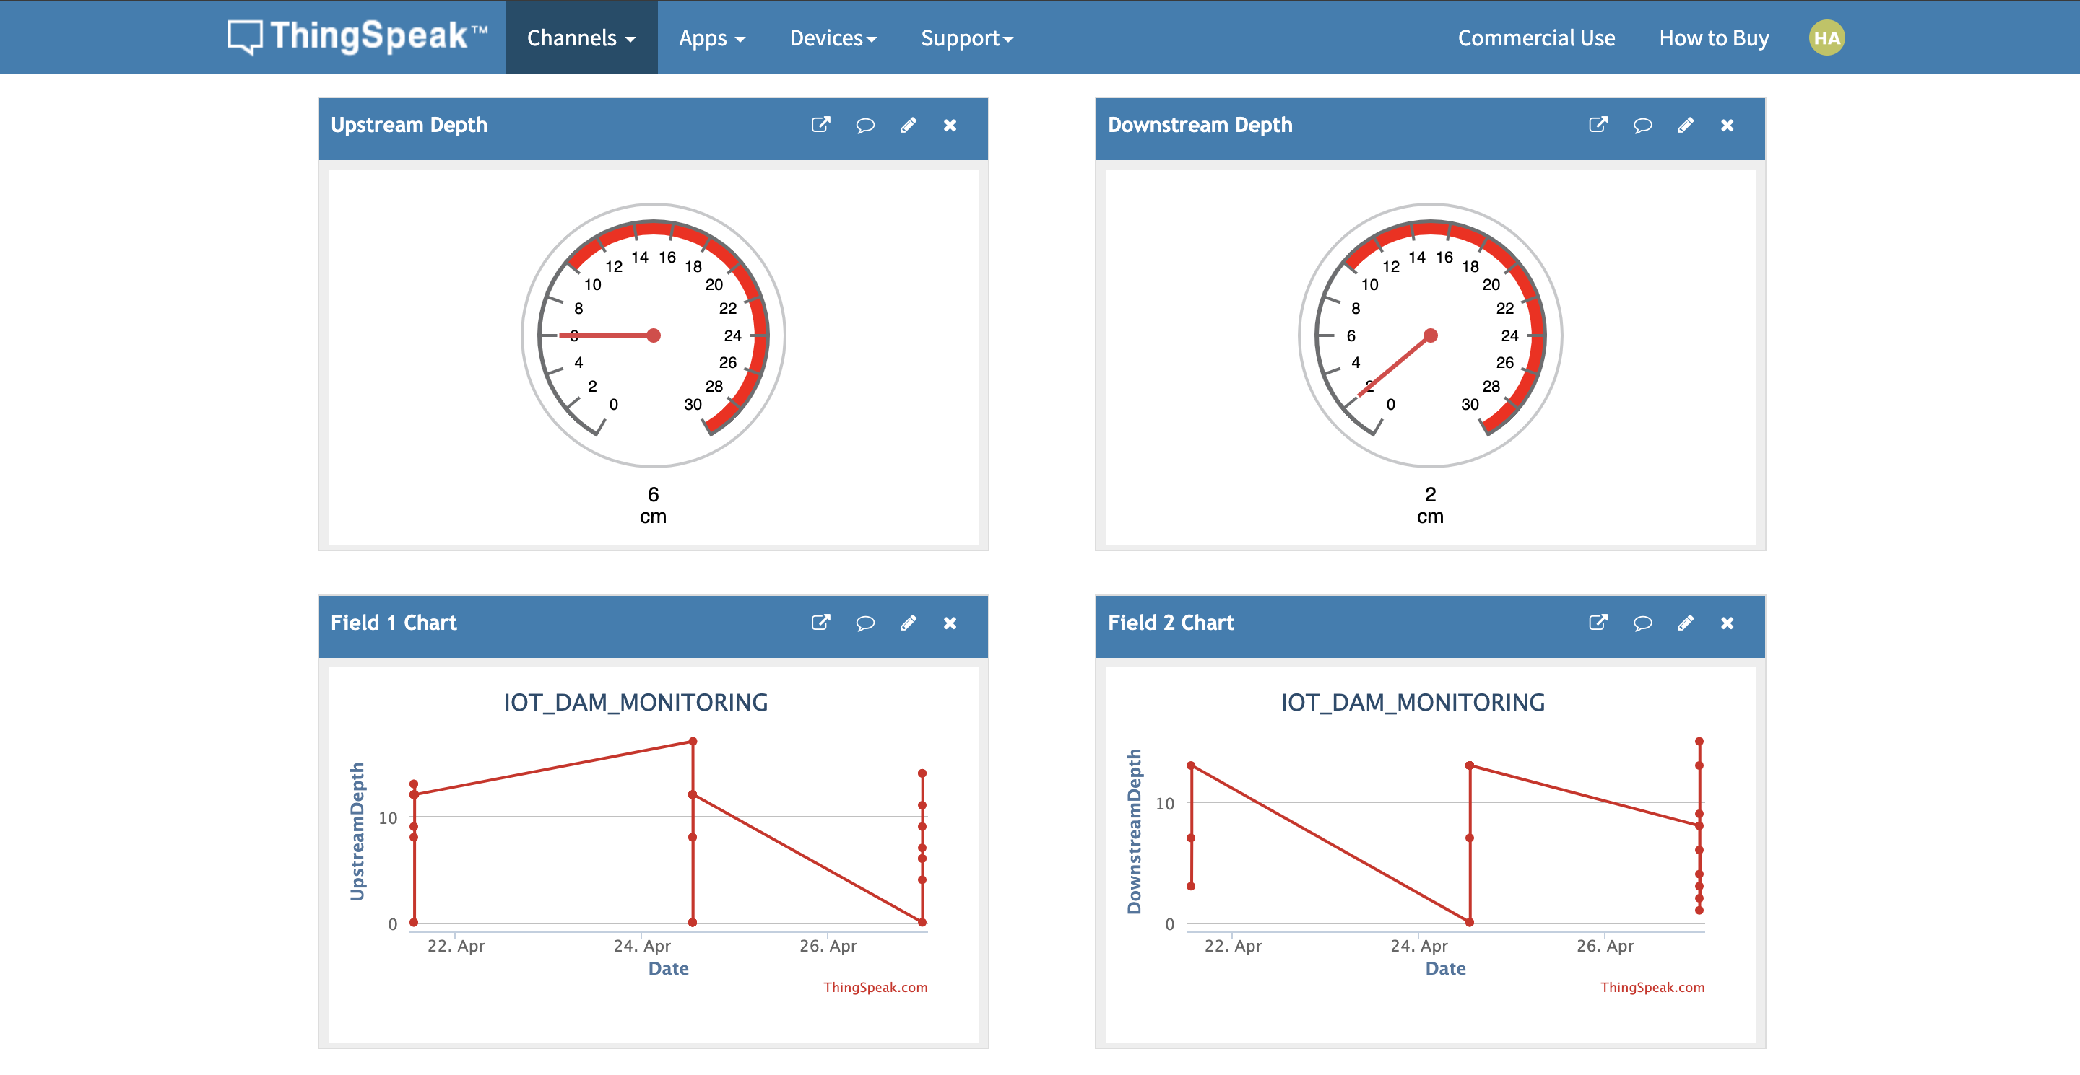
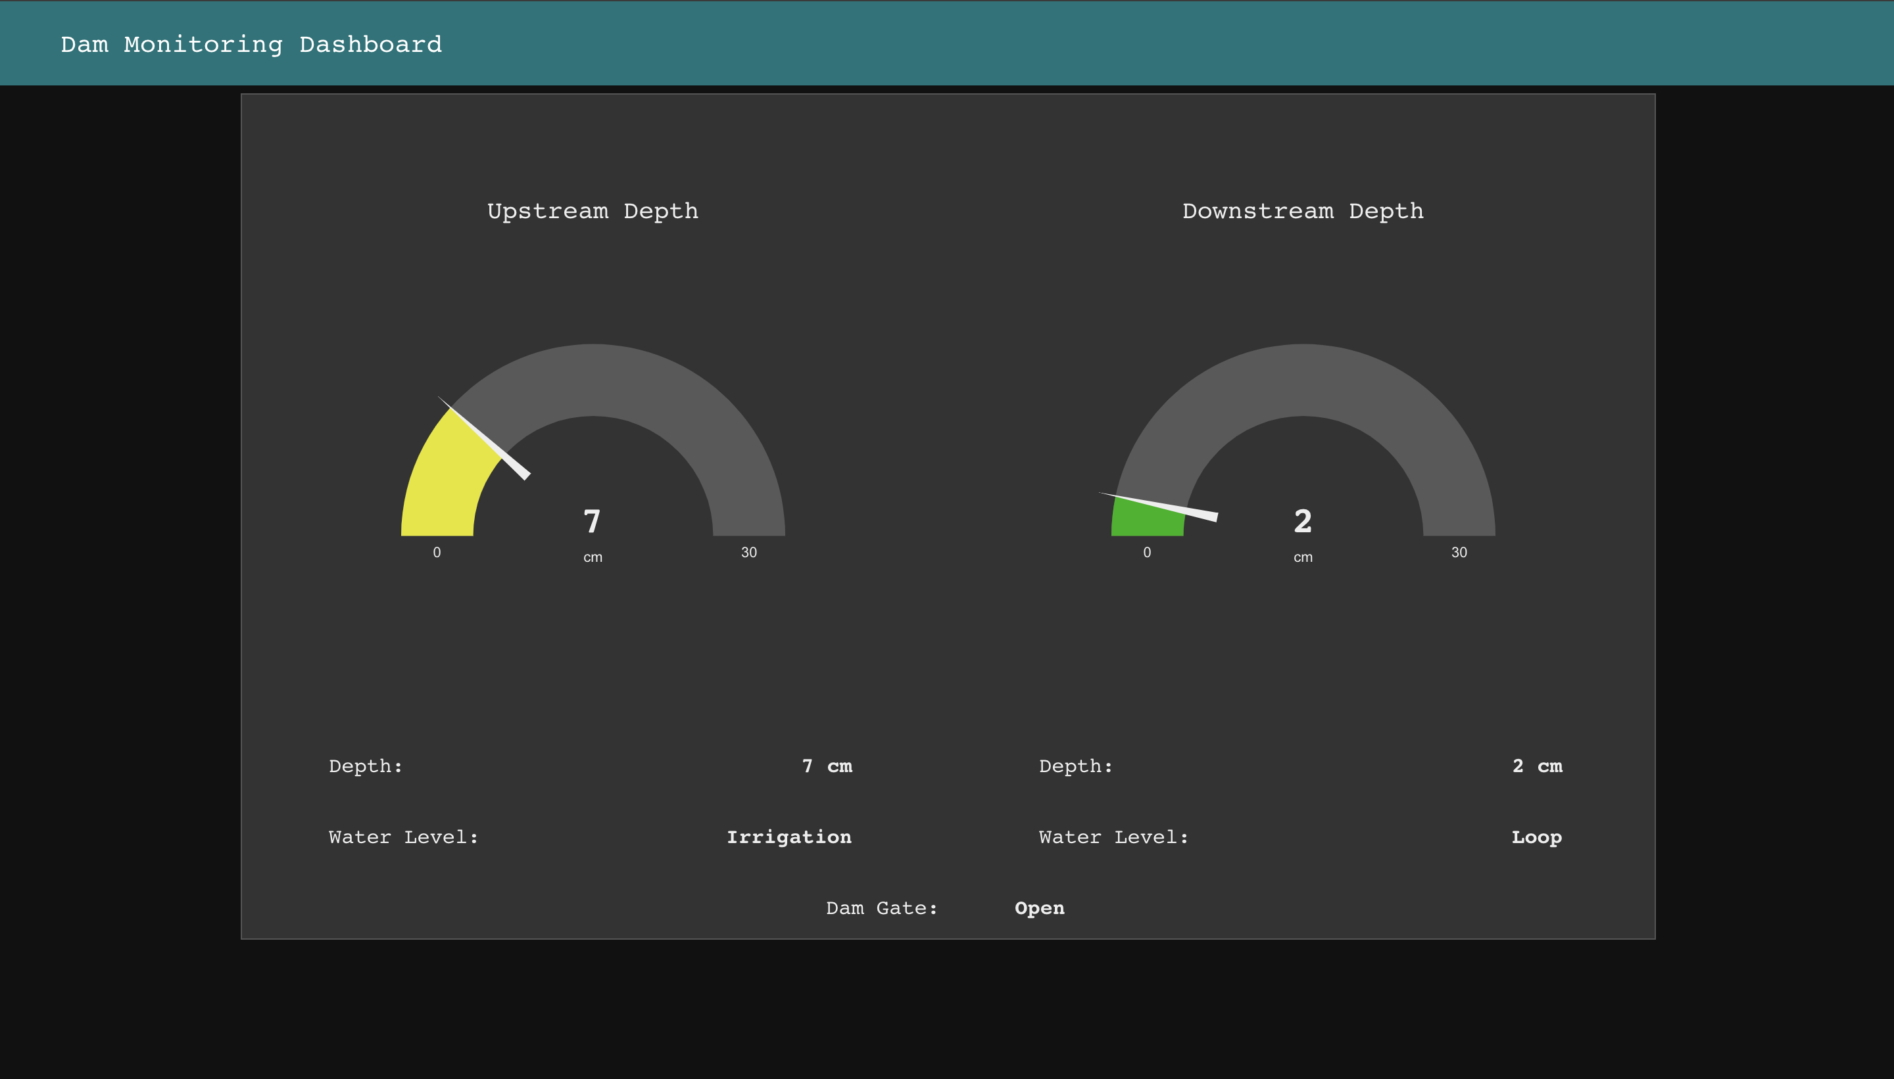
Downstream lies in loop level
ThingSpeak showing realtime data
Dam gates open

Slide 20
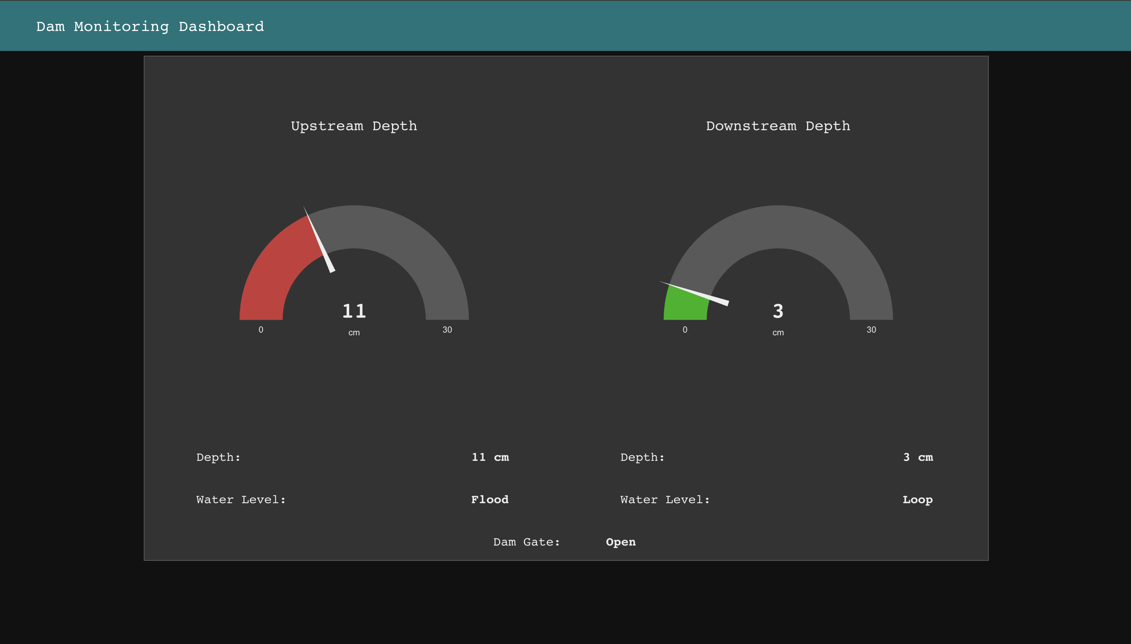
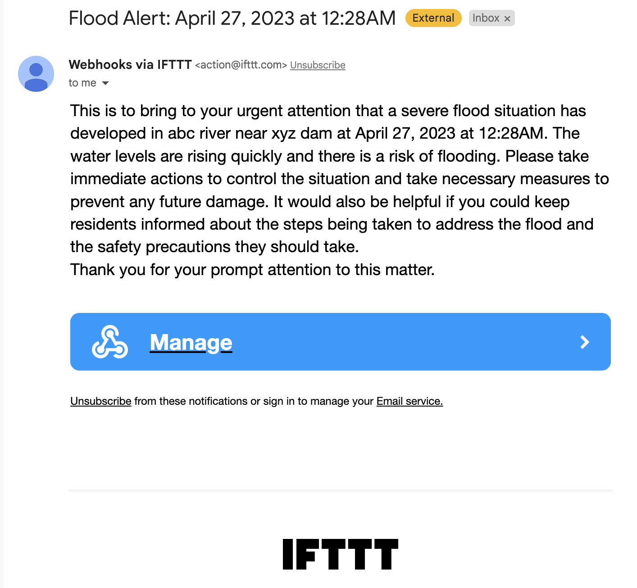
Upstream reaches the flood level
Dam gates open
Alert Email sent to authorities

Slide 21
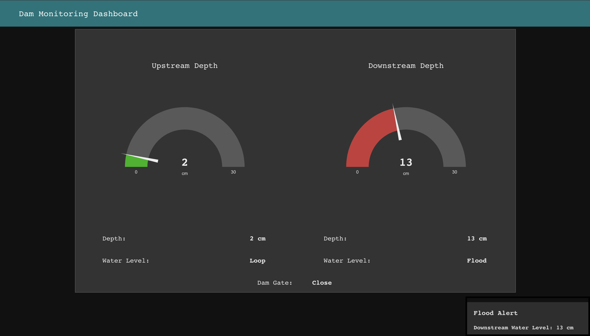
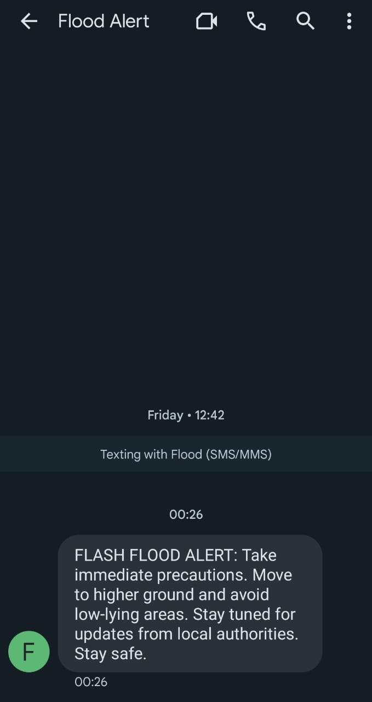
Downstream reaches the flood level
Dam gates close
Alert message sent to residents

Slide 22
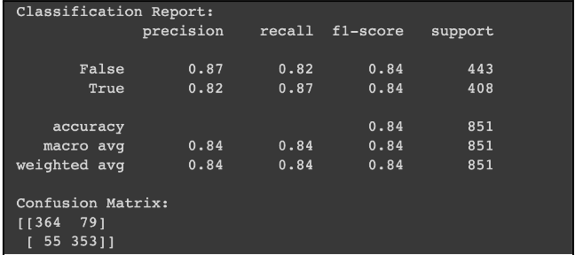
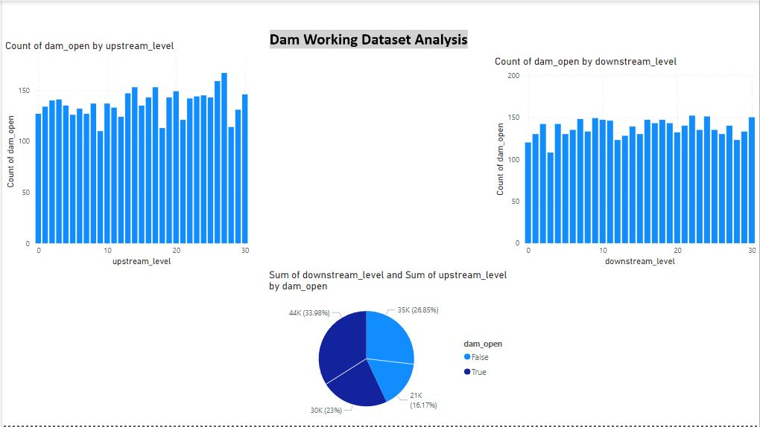
PERFORMANCE ANALYSIS
Confusion matrix
Data visualization using PowerBI

Slide 23
Issues
Difficulty in finding find effective dataset
Integration of ML model
Integration of some hardware components

Slide 24
Conclusion and Future Work
According to our tests, the system has shown promising results when faced with the typical problems encountered by other dam monitoring and alerting systems. All the test cases work properly and all the hardware components respond properly during trigger conditions.
In future, it is aimed to take into consideration natural phenomenon like rain for dam monitoring. We will try to build a machine-learning model to predict chances of rain and further use this prediction for controlling the dam working.

Slide 25
Link to Github Repo.
Dam monitoring and Alerting system

Slide 26
S No. | Materials | Prices(in Rs)
1. | Arduino UNO | 659
2. | Ultrasonic Sensors | 119
3. | Servo Motor | 150
4. | LED lights | 20
5. | Breadboard | 120
6. | Jumper wires | 159
7. | Buzzer | 40
8. | Miscellenous | 300
 | TOTAL | 1500

Slide 27
Thank You
Do you have any questions ?
Feel free to ask

